Slide 1

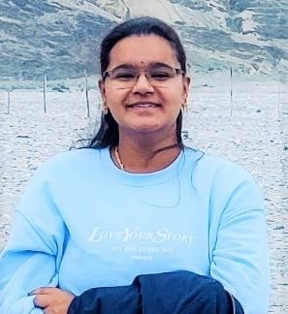



Kalaga Sri Durga Srija
Education and certificates
Bachelor of Technology
Civil Eingineering : 2017 - 2021
Analyst/Software Engineer
Base Location: Bangalore
Skills
Clanguage
SQL
Excel
AutoCad
SoftSkills
Email ID: srijakalaga@gmail.com
_{Mobile No: +91 9182957544}
Grade:
A4
Database
SQL database – MySQL
No SQL database – MongoDB
Strengths
A self driven learner with Front-End and Back-End knowledge. Passionate about implementing and launching new projects.
Ready to learn new technologies/Frameworks and implement them to further improve my knowledge.
A team player with good communication skill always ready to work for the enrichment of knowledge.
Has working knowledge on SSIS and Visual Studio and Azure pipelines as a Begineer + level
Achivement
Moving object desktop game using 'C
Interactive moving object game has been developed using “C” language
The game closely resembles the snake game we usually play on mobile phones
The game was built using various inbuilt and user defined functions
Inbuilt functions are required to identify key strokes and also to create random point fetching objects ( called fruits in the game)
User defined functions are required to identify the boundary of the game area, to perform appropriate action upon identifying a key stroke and also for the game screenplay like show the start/ end of the game and also to show points earned etc.
As a final year project in engineering.
2. Presently working in a Altria Project As a Data Analyst.
Web Technologies
SSIS
VisualStudio
Azure
Additional Details
Excellent Communication Skills
Team Player
Also Implemented Sql in case study and upskilling day by day.
Presentation Title | Author | Date © Capgemini 2017. All rights reserved | 1

